Slide 1

BLOCKCHAINS
ARCHITECTURE, DESIGN AND USE CASES
PRAVEEN JAYACHANDRAN
IBM RESEARCH,
INDIA
SANDIP CHAKRABORTY
COMPUTER SCIENCE AND ENGINEERING,
IIT KHARAGPUR

Slide 2
Conceptualization and APPLICATIONS
Image courtesy: http://beetfusion.com/

Slide 3
The Permission-less Model
Works in an open environment and over a large network of participants
The users do not need to know the identity of the peers, and hence the users do not need to reveal their identity to others
Good for financial applications like banking using cryptocurrency

Slide 4
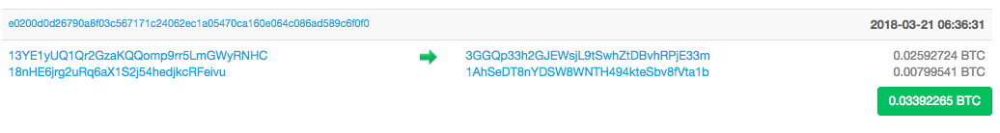
Privacy and Security
The system is tamper-proof – it is “extremely hard” to make a change in the blockchain
Tampering the system becomes harder as the chain grows
For Bitcoin, the transactions are pseudo-anonymous
Transactions are sent to public key addresses,- cryptographically generated addresses, computed by the wallet applications

Slide 5
Peer Addresses (Reference: Bitcoin)
“Address” in bitcoin is synonymous to an “Account” in a bank.
The wallet listens for transactions addressed to an account,
Encrypts the transactions by the public key of the target address
Only the target node can decrypt the transaction and accept it
However, the actual transaction amount is open to all for validation

Slide 6
Blockchain (at Permission-less Model) as a Tree
Block 3
Block 6
Block 1
Block 2
Block 5
Block 7
Block 8
Block 12
Block 4
Block 9
Block 11
Block 10
The longest chain is the accepted chain

Slide 7
Accepting the Longest Chain

Slide 8
Accepting the Longest Chain

Slide 9
Accepting the Longest Chain
A new block is mined

Slide 10
Accepting the Longest Chain
Always include it in the longest chain

Slide 11
Orphaned Blocks
Block 3
Block 6
Block 1
Block 2
Block 5
Block 7
Block 8
Block 12
Block 4
Block 9
Block 11
Block 10
The blocks which are not part of the longest chain

Slide 12
The Cryptocurrency Applications using Blockchain
Currency | Status | Release | Features
Bitcoin (BTC) | Active | 2009 | The first decentralized ledger currency
Litecoin (LTC) | Active | 2011 | The first cryptocurrency that uses Scrypt as a hashing algorithm
Bytecoin (BCN) | Active | 2012 | Focused on user privacy through impassive and anonymous transactions
Peercoin (PPC) | Active | 2012 | Uses PoW and PoS functions
Emercoin (EMC) | Active | 2013 | Trusted storage for any small data (DNS, PKI, SSL infrastructure etc.)

Slide 13
The Cryptocurrency Applications using Blockchain
Currency | Status | Release | Features
Ripple (XRP) | Active | 2013 | Designed for P2P debt transfer
Waves | Active | 2016 | An open blockchain platform to develop applications for high volume transactions
Omni (MSC) | Active | 2013 | Both a digital coin and a communication platform built on top of bitcoin blockchain
Gridcoin (GRC) | Active | 2013 | The first cryptocurrency linked to citizen science through Berkley Open Infrastructure for Network Computing

Slide 14
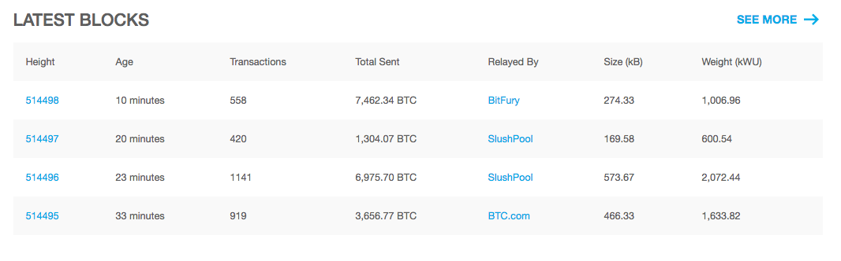
Bitcoin Block Explorer
Source: https://blockchain.info/

Slide 15
The Permissioed (Private) Model – Blockchain 2.0
Blockchain can be applied just beyond cryptocurrency
The underlying notions of consensus, security and distributed replicated ledgers can be applied to even closed or permissioned network settings
Most enterprise use cases only involve a few ten to a few hundred known participants

Slide 16
Permissioned Blockchain
Can leverage the 30+ years of technical literature to realize various benefits like
Strict notion of security and privacy
Greater transactional throughput based on the traditional notions of distributed consensus
Raft Consensus
Paxos Consensus
Byzantine Fault Tolerance (BFT) algorithms

Slide 17
Permissioned Blockchain Applications
Source: https://www.multichain.com
Asset Movements and Tracking

Slide 18
Permissioned Blockchain Applications
Provenance tracking - tracking the origin and movement of high-value items across a supply chain, such as luxury goods, pharmaceuticals, cosmetics and electronics.
When the high-value item is created, a corresponding digital token is issued by a trusted entity, which acts to authenticate its point of origin.
Every time the physical item changes hands, the digital token is moved in parallel -> the real-world chain of custody is precisely mirrored by a chain of transactions on the blockchain.
The token is acting as a virtual “certificate of authenticity”, which is far harder to steal or forge than a piece of paper.

Slide 19
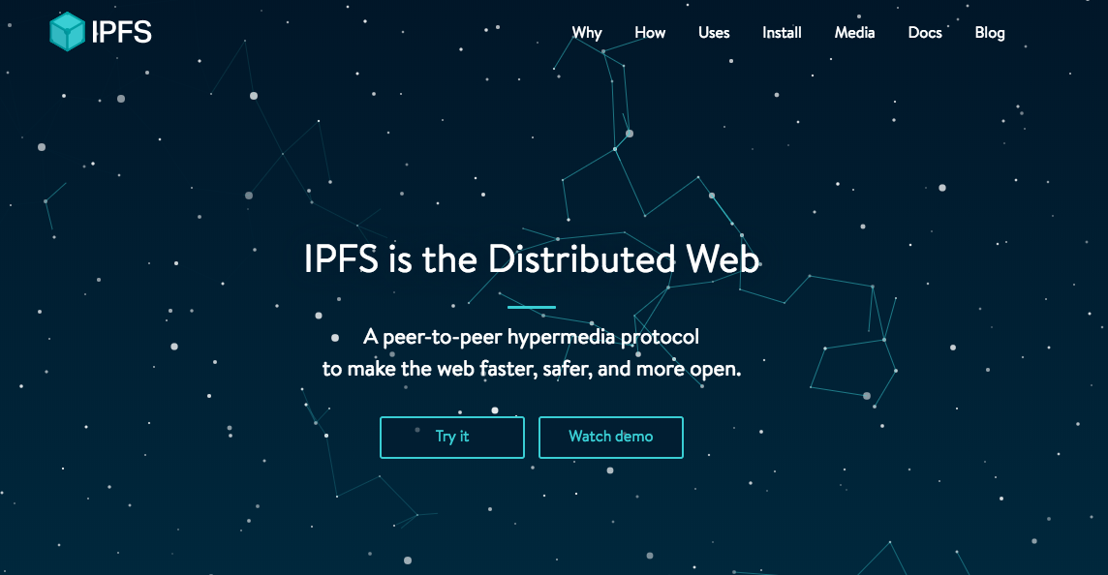
The Blockchain Based Distributed Web

Slide 20
How IPFS Works
Each file and all of the blocks within it are given a unique fingerprint based on a cryptographic hash
IPFS removes duplications across the network and track version history for every file
Each network node stores only the content it is interested in and some indexing information that helps to figure out who is storing what
Source: https://ipfs.io/

Slide 21
How IPFS Works
When looking up files, you ask the network to find nodes storing the content behind a unique hash
Every file can be found by human readable names using a decentralized naming system called IPNS
Source: https://ipfs.io/

Slide 22
Hyperledger Fabric
A permissioned blockchain framework that provides an enterprise-grade foundation for transactional applications
A shared ledger that supports smart contracts – ensures security and integrity of recorded transactions
Unlike Bitcoin and Ethereum, Hyperledger Fabric supports privacy and confidential transactions

Slide 23
Hyperledger Fabric
Fabric supports the notion of channels, a “subnet” of peers within the network that wants to share information confidentially
Gives restricted visibility - important for business applications
Fabric has no notion of mining, use the notion of distributed consensus under a closed environment

Slide 24
The Fabric Network
Source: IBM Code Tech Talk

Slide 25
Summary
Two models of Blockchain network – Permission-less (an open environment) and Permissioned (a close environment)
Permission-less model is suitable for open control-free financial applications like cryptocurrency
Permissioned model is suitable for business applications like smart contract

